Slide 1

TUPLE

Slide 2
SESSION OVERVIEW:
DEFINITION
CREATION
ACCESS & SLICING
DELETION
METHODS & BUILT-IN FUNCTIONS
OPERATIONS

Slide 3
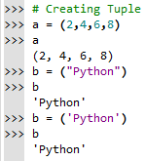
DEFINITION
A Tuple is Created by placing all the elements inside a Bracket ( ) separated by commas ,
A Tuple can have any number of elements even of Different Data Types.
SYNTAX :
<variable_name> = (element1,element2,…..)

Slide 4
TUPLE | LIST
Tuples are immutable, i.e., we can't update its data. | List are mutable, i.e., we can update its data.
Tuples are denoted by round parenthesis around the elements. | Lists are denoted by square brackets around the elements.
Iteration are faster than List | Iteration are slow compared to Tuple
Generally, we use Tuple for Heterogenous (Different) Datatypes | we use List for Homogenous (Similar) Datatypes
If you have data that doesn’t Change ,
Implementing it as tuple will guarantee
That it Remains Write Protected.

Slide 5
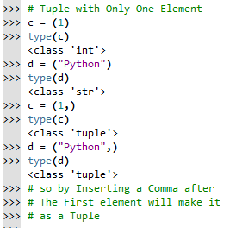
Similar to List , Tuple can also have single or Mixed Datatypes in it and even Empty Tuple.
A Tuple can have another Tuple in it ,called as Nested Tuple.
But Creating Tuple with only one Element is a Bit Tricky.

Slide 6
ACCESSING
Indexing [2]
Negative indexing [-2]
Slicing [ : ]
A = | A | P | P | L | E
POSITIVE | 0 | 1 | 2 | 3 | 4
NEGATIVE | -5 | -4 | -3 | -2 | -1

Slide 7


ERRORS !
Index Error : Trying to Access an Element out of the Range
Type Error : Index Value Other than Integer

Slide 8
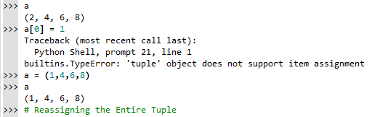
CHANGING VALUES
In Python, the Tuples are Immutable, which means they cannot be changed.
A Tuple element or range of elements can be changed or altered by using Reassignment

Slide 9
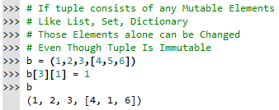
As Discussed above , We Cannot change the Elements in a Tuple. That also Means
we cannot Delete or Remove items
From a Tuple. But Deleting Entire Tuple is
Possible by Using ‘del’ keyword

Slide 10
METHODS
Tuple has only Two Methods :
index() – Returns the Index value of the first Matched element
count() – No of Times the given Value is Repeated in the list

Slide 11
BUILT-IN FUNCTIONS
all() – Returns True if all the items are True(values other than zero ‘0’) or empty. ≈ Logical And
any() – Returns True if any 1 items is True(values other than zero ‘0’) ≈ Logical Or . If Empty then False

Slide 12
enumerate() - Returns the Tuple as Values followed by their Index Number. * NOTE this function is not available for tuple
len() – returns the Length of the tuple( no. of items in it)
tuple() – to convert the other datatypes into Tuple
max() – greatest value in the tuple
min() – smallest value in the tuple
sum() – adds all the value in the tuple & returns it
sorted() – Returns a New Sorted tuple . * NOTE it does not sort the tuple itself

Slide 13
OPERATIONS
Repetition & Concatenation
Membership Test
Iteration

Slide 14
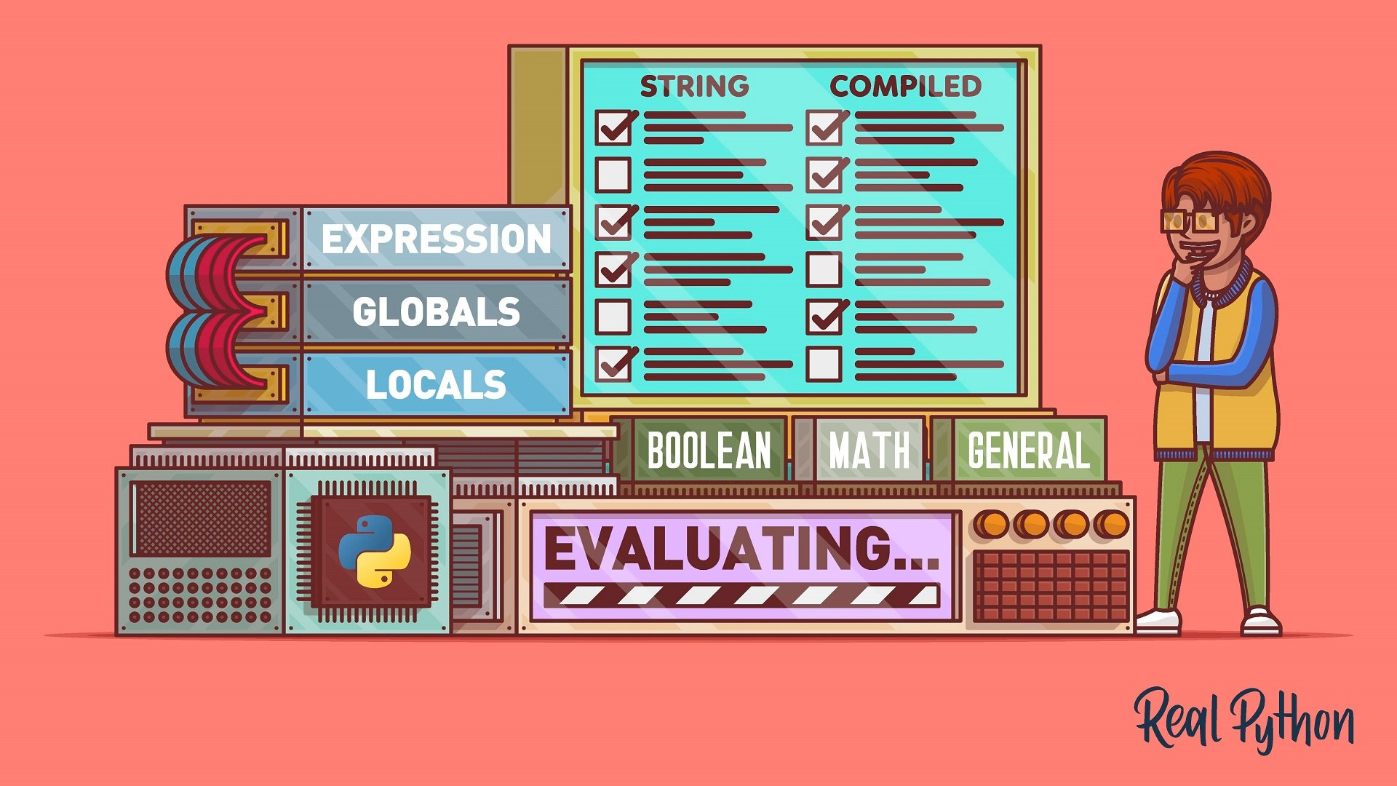
CODING IS FUN ! THANK YOU !!

